Slide 1
Pizza Report
Using SQL

Slide 2




Slide 3

Retrieve the total number of order placed.

Slide 4
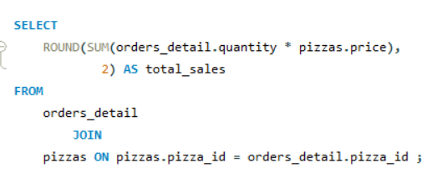
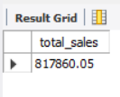
Calculate the total revenue generated from pizza sales.

Slide 5
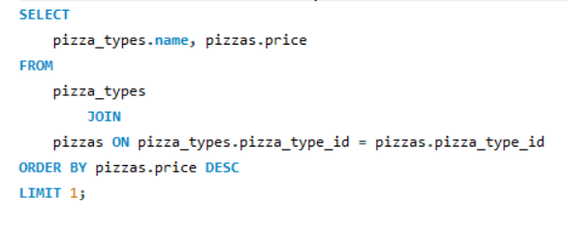
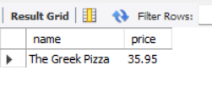
Identify the highest-price pizza.

Slide 6
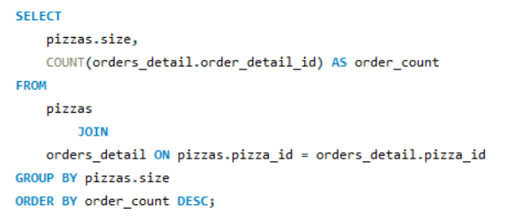
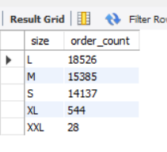
Identify the most common pizza sized ordered.

Slide 7
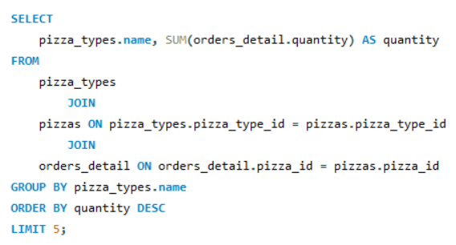
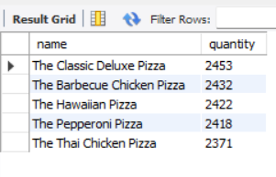
List the top 5 most ordered pizza type. Along with their quantities.

Slide 8
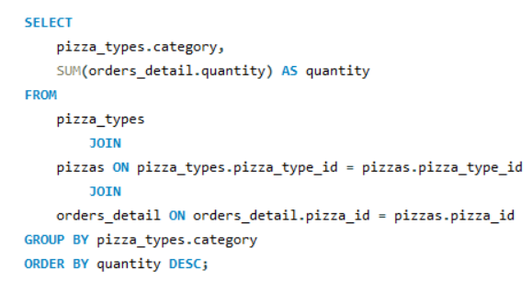
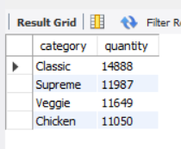
Join the necessary table to find the. Total quantity of each pizza category order

Slide 9

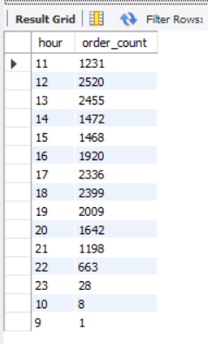
Determine the distribution of orders by hour of the day.

Slide 10

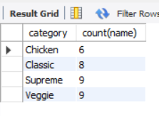
Join relevant table to find the. Category-wise distribution of pizzas.

Slide 11
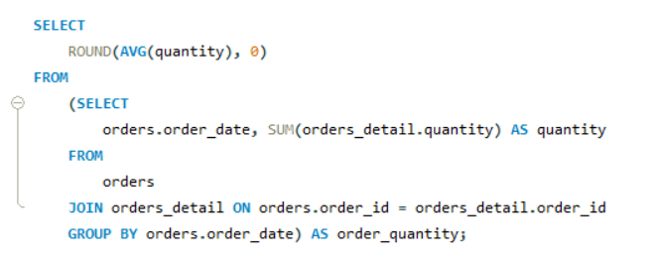
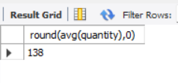
Group the orders by date and calculate the average alter. Number of pizza ordered per day.

Slide 12
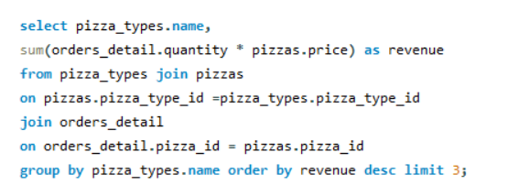
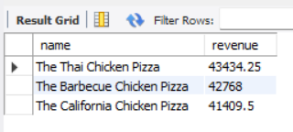
Determine the top 3 most ordered. Pizza type based on revenue.

Slide 13
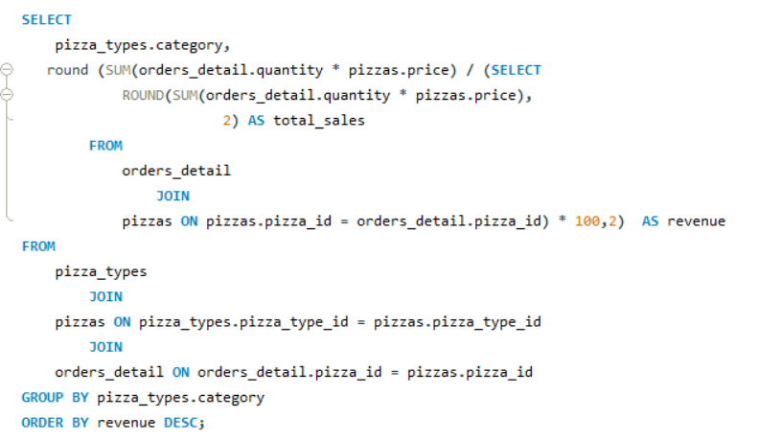
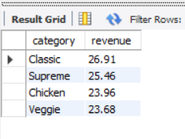
Calculate the percentage contribution of each. Pizza type to total revenue.

Slide 14
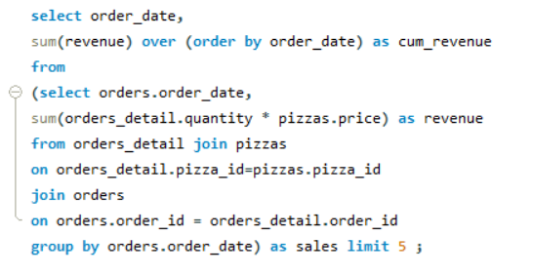
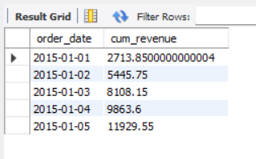
Analyze the cumulative revenue generated over time.

Slide 15
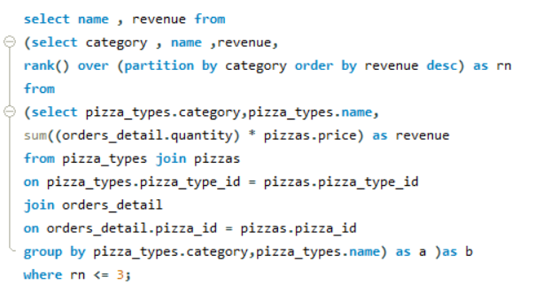
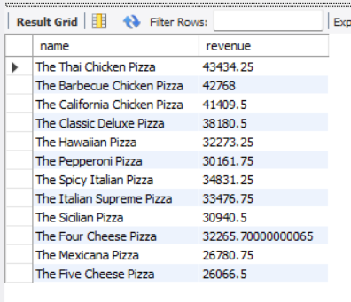
Determine the top 3 most ordered pizza type. Based on revenue for each pizza category.

